Slide 1
AI Agents
A Beginner's Guide
with Applications for Indian Railways A&F

Slide 2
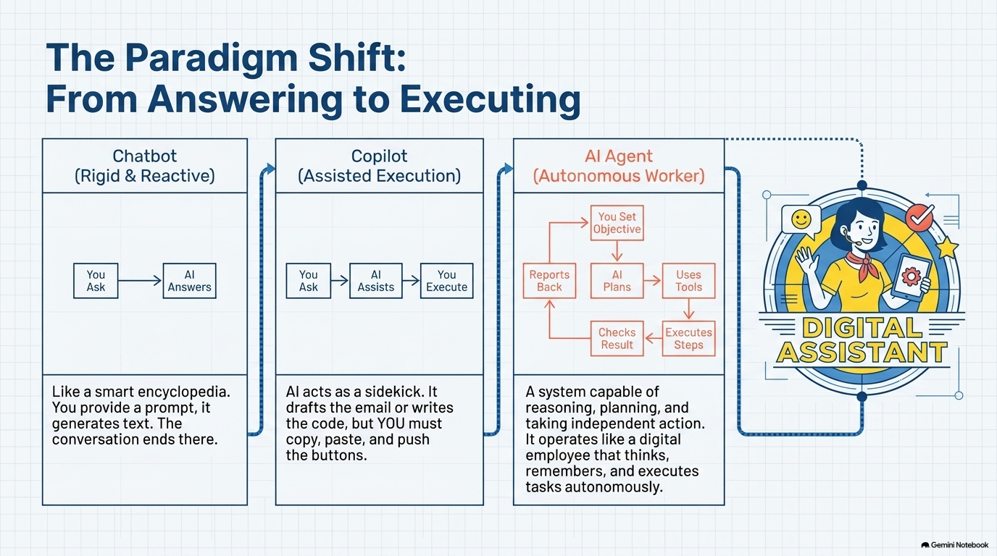

Slide 3

Autonomous Digital Workers
AI Agents Function as Autonomous Digital Employees
The Digital Worker Paradigm
A system capable of reasoning, planning, and taking independent action.
Operates like a digital employee that thinks, remembers, and executes tasks autonomously.
Key Pillars
LLM
Memory
Tools

Slide 4
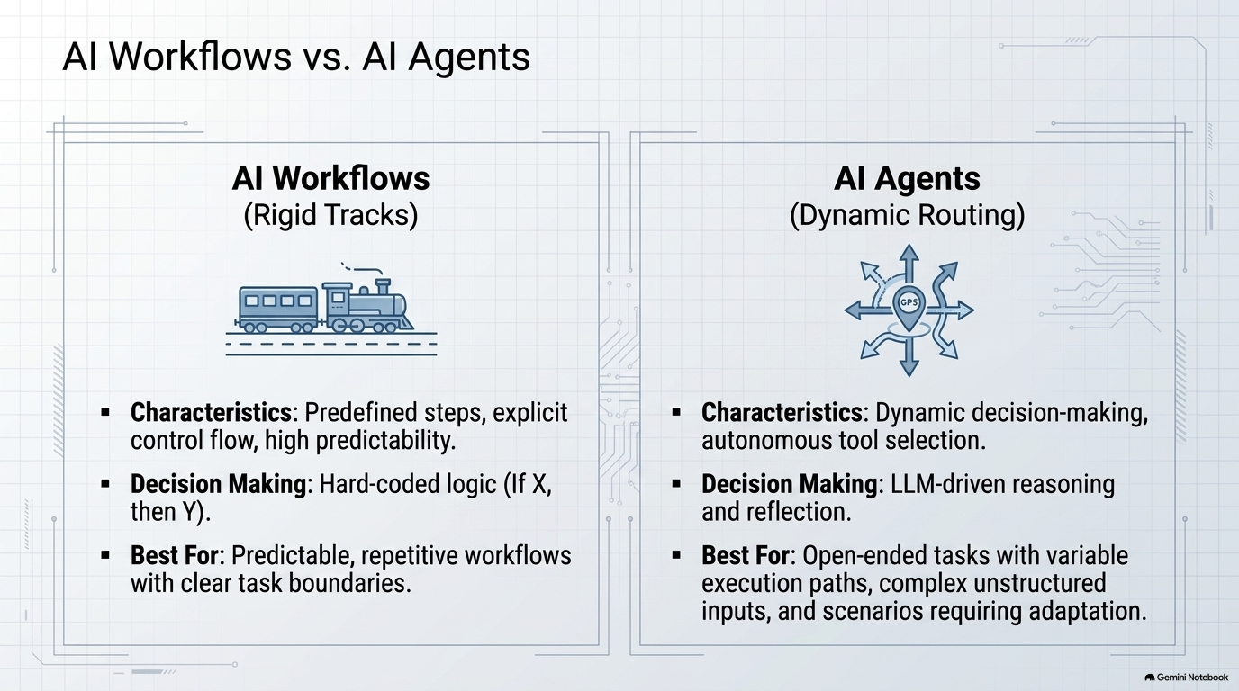

Slide 5
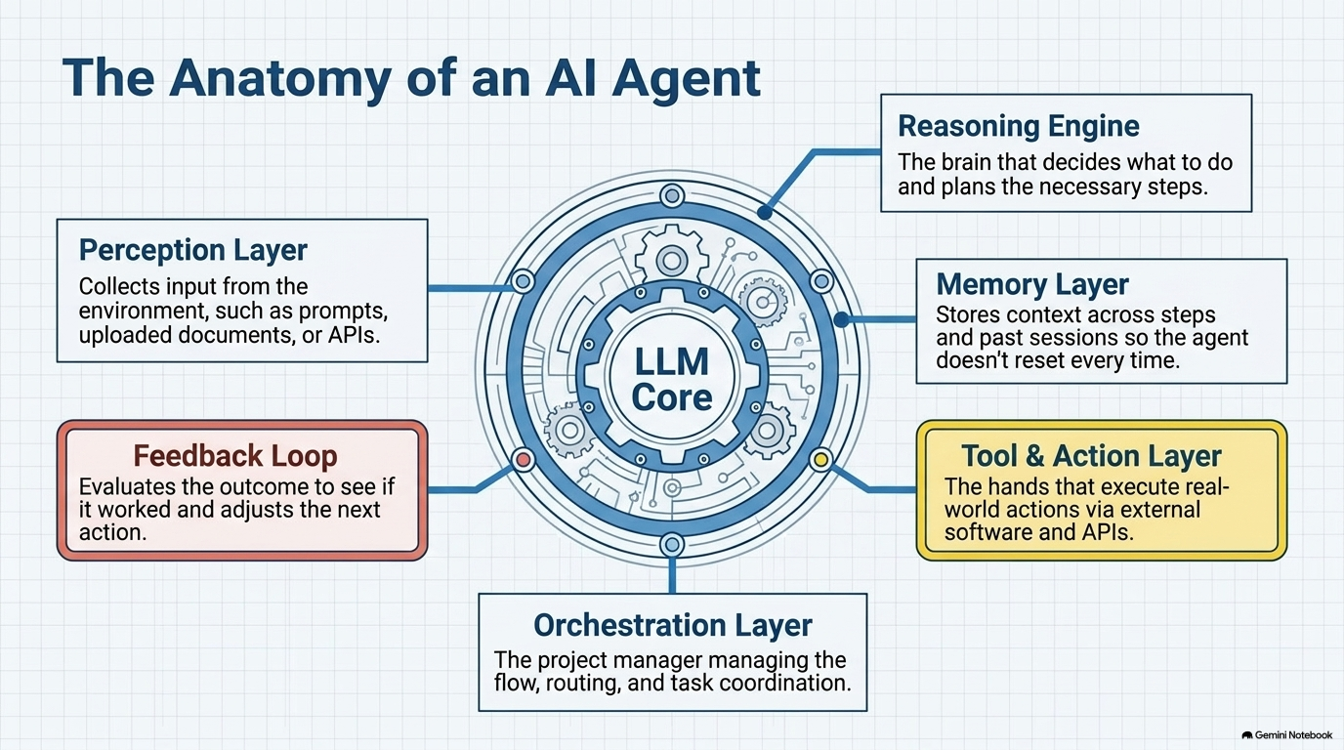

Slide 6

Cognitive Architecture
Large Language Models Provide the Reasoning Engine
The Core Decision Engine
Role: Large Language Models (LLMs) like GPT, Claude, or Gemini provide the core reasoning capabilities.
Function: Interprets natural language instructions and decides the next best action.

Slide 7

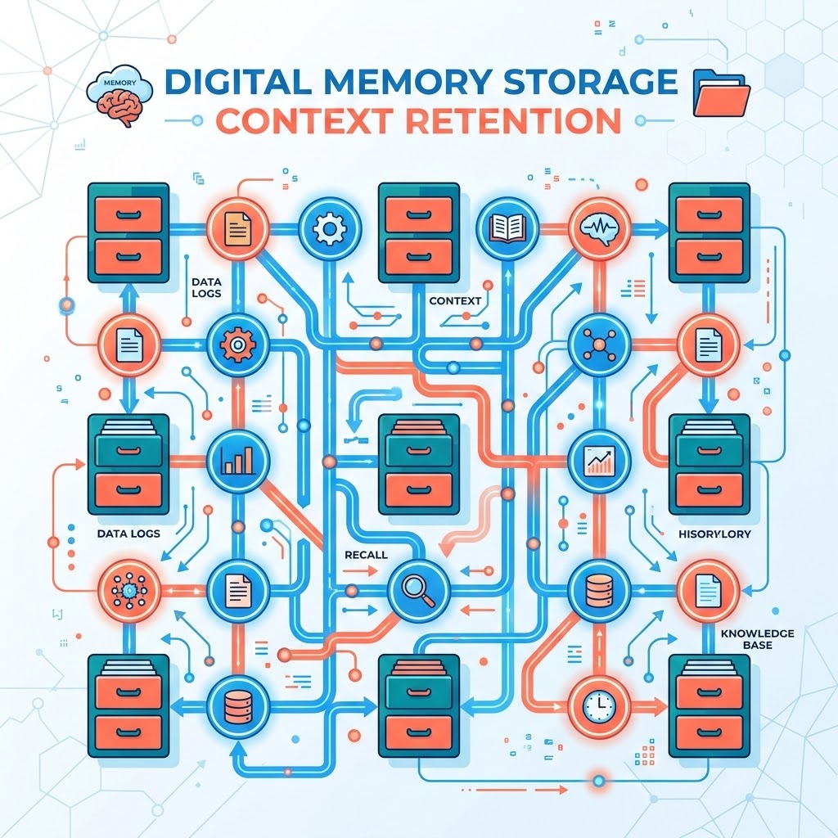
STATE RETENTION
Memory Retains Context for Better Decision-Making
01 / ROLE
Retains information from past interactions or external databases.
02 / BENEFIT
Enables better decision-making by keeping track of the overall conversation or process state.

Slide 8
Agent Capabilities
Tools Connect Agents to External Systems
Connects the agent directly to external systems and databases to retrieve data and execute actions.
Data Retrieval
Connects the agent to critical data sources. Allows it to query databases, scan tables, and retrieve specified records to make informed, context-aware decisions.
Communications
Bridges the gap between the core agent and standard collaborative tools. Enables sending emails, firing automated messages, or dispatching urgent alerts.
System Orchestration
Empowers the agent to push updates back into spreadsheets, sync tables, trigger custom webhooks, or query unique internal APIs to automate manual workflows.

Slide 9
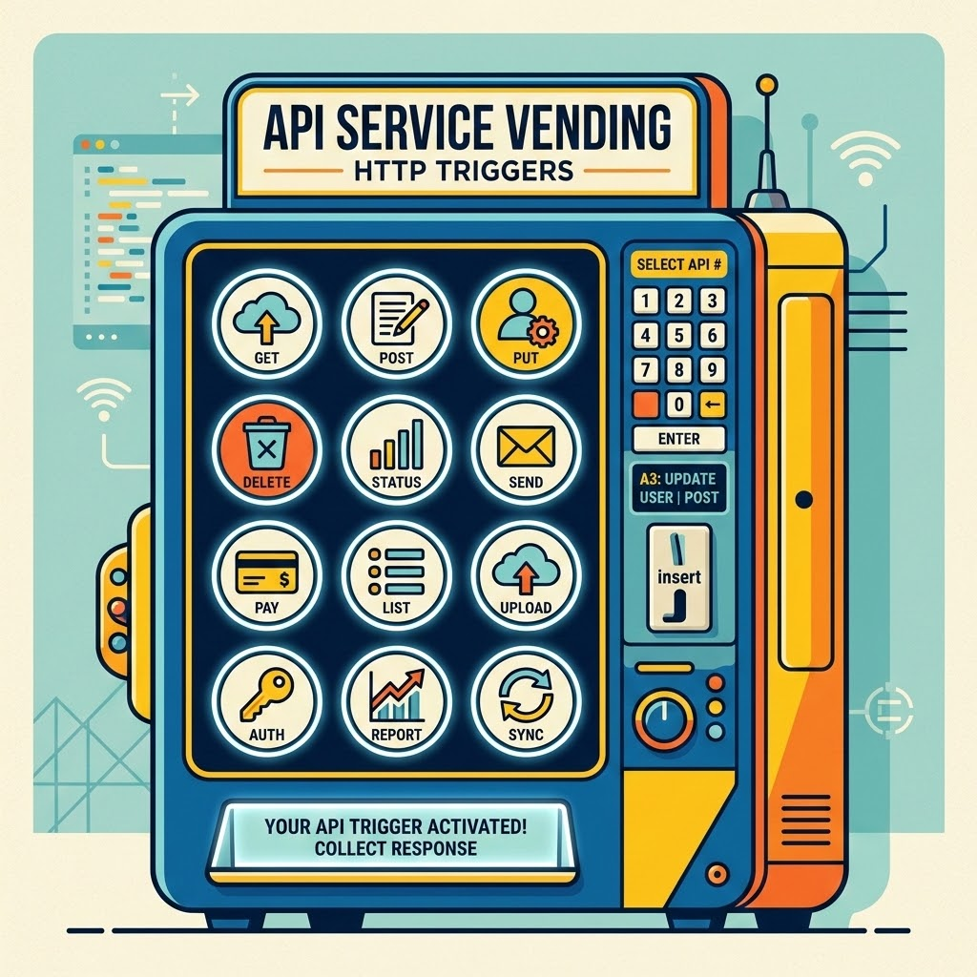
Concept Mapping
APIs & HTTP Requests
Core mechanism for programmatically fetching data or triggering actions across external systems without manual intervention.
Utility: Allows autonomous AI agents to read from or write to external software services seamlessly without manual intervention.
APIs are the interface: The vending machine displays the available options, while an HTTP request acts as pressing the button to retrieve the desired item.

Slide 10
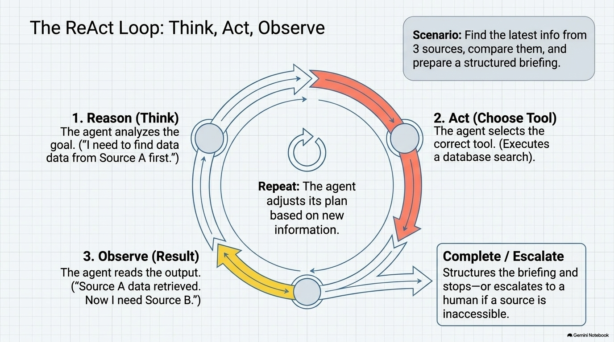

Slide 11




Agent Architectures
Agent Structures Mirror Human Organizations
Single-Level
Flat Workflow
One agent handles all tasks directly (like a flat startup structure).
Multi-Level
Hierarchical Group
A manager agent delegates tasks to specialized sub-agents (similar to a corporate hierarchy).
Research Task
Research Sub
SINGLE
AGENT
MANAGER
AGENT
IN
Drafting Task
IN
Drafting Sub
Publishing Task
Publishing Sub

Slide 12
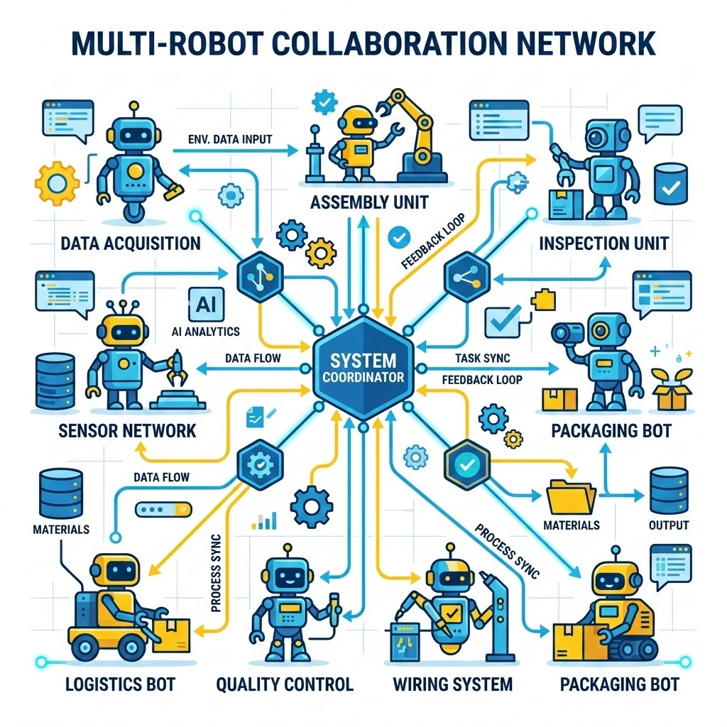
Multi-Agent Systems
Agent Swarms Solve Complex Multi-Step Problems
Networks of highly specialized agents collaborating.
Advantage: Solves complex, multi-step problems through decentralized cooperation and task delegation.

Slide 13
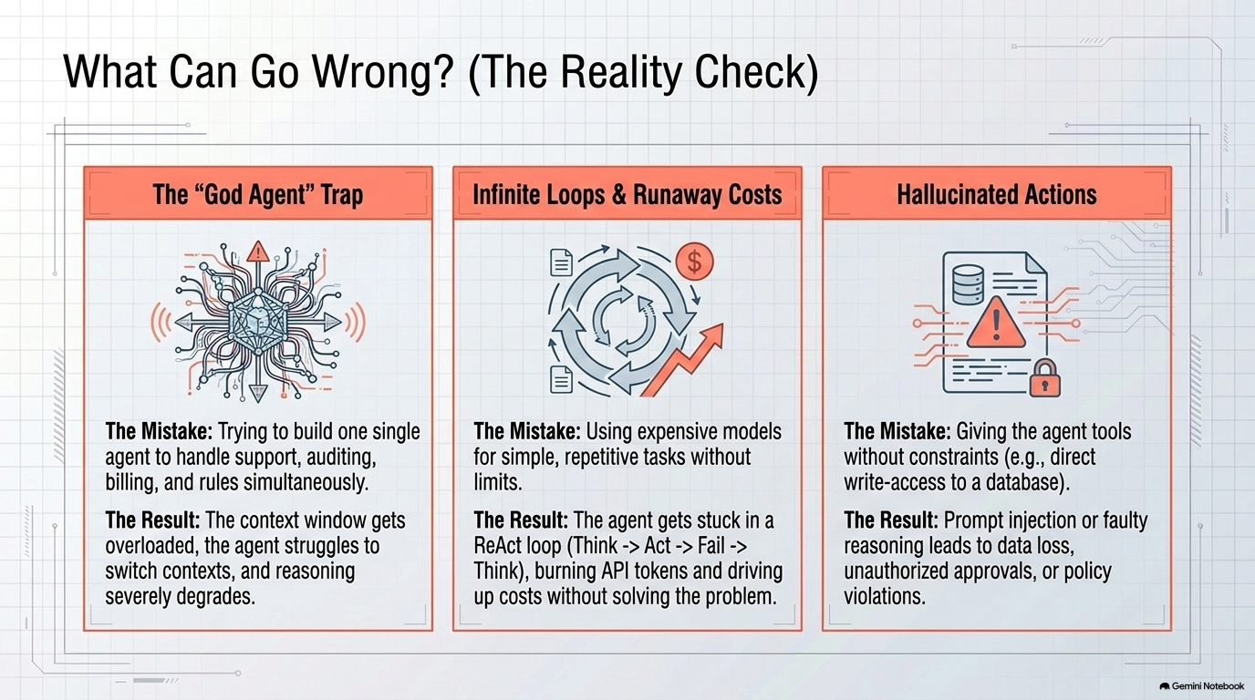

Slide 14
Agentic Application in Railway Accounts and Finance

Slide 15
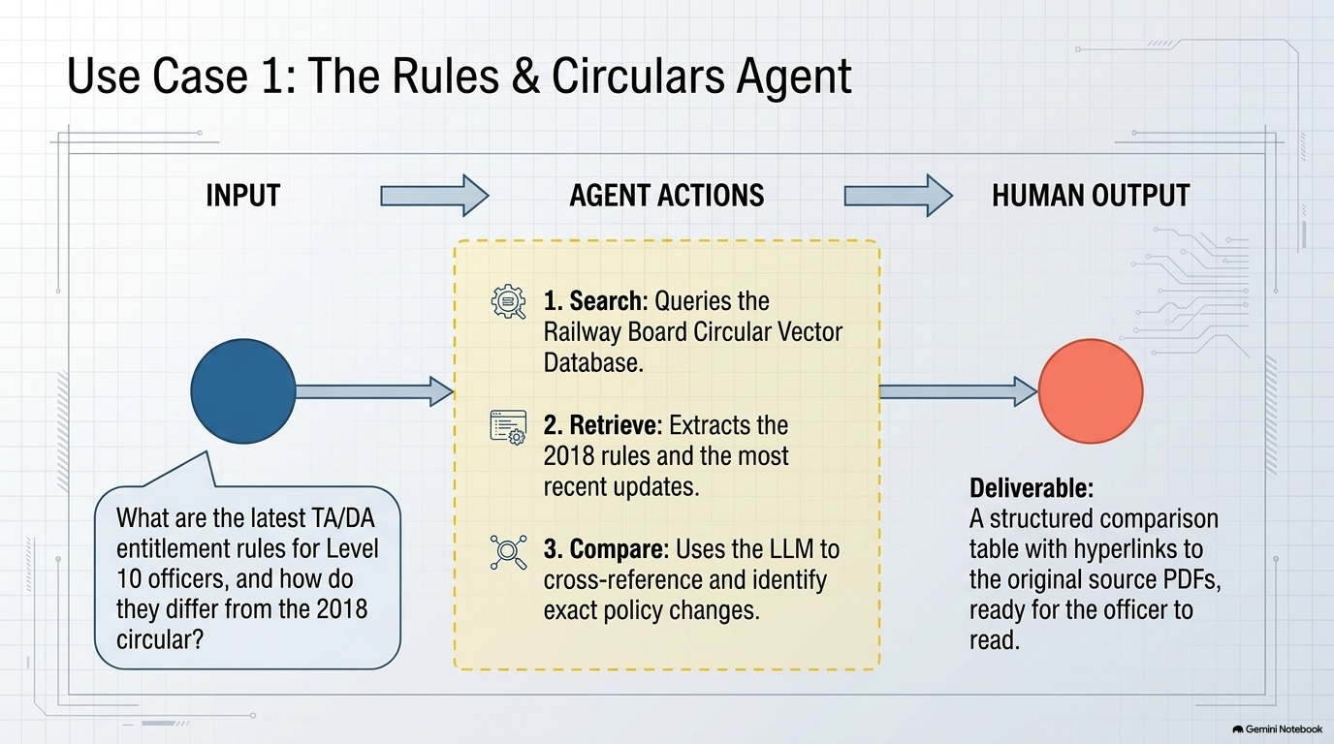

Slide 16
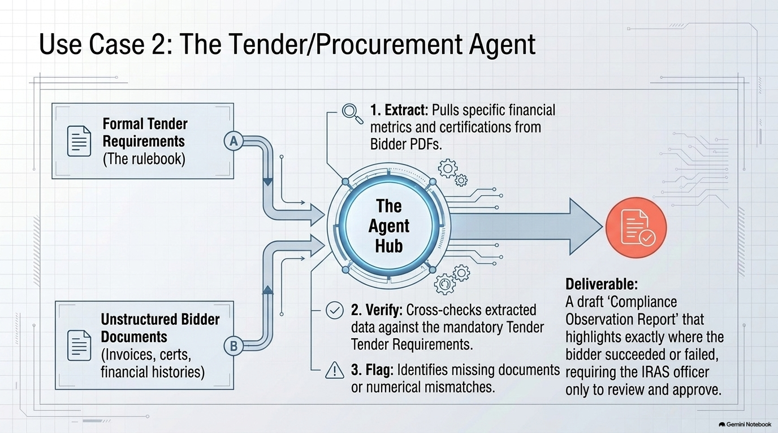

Slide 17
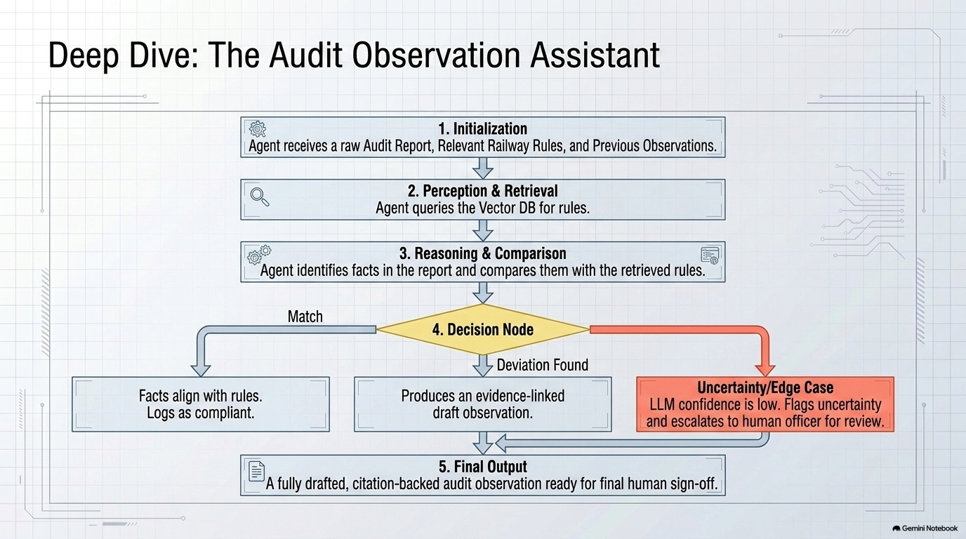

Slide 18

FINANCIAL AUTOMATION
Revenue Reconciliations
Core Application
Automates station balance sheet checking and matching passenger earnings with banking data.
Impact
Detects mismatches early and reduces reconciliation turnaround times.

Slide 19
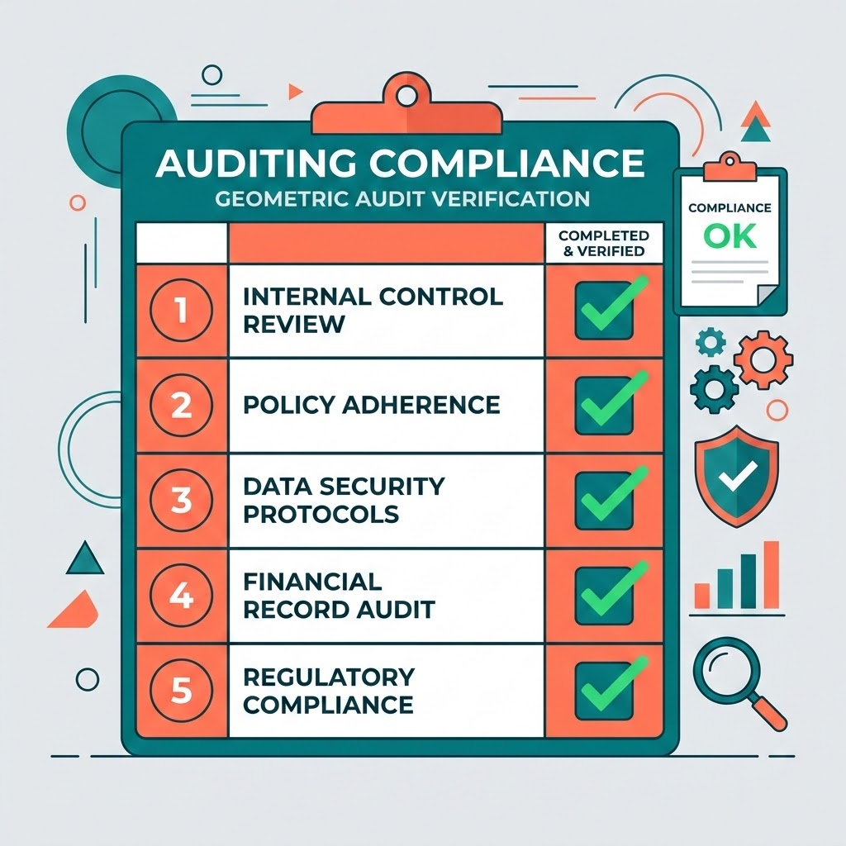
Compliance Automation
AI Agents for Continuous Policy Compliance
Automated Financial Guardrails
Deploying dedicated AI agents ensures 100% coverage of financial transactions, shifting compliance from reactive auditing to real-time, continuous enforcement.
Core Application: Auditing contractor bills, TA claims, and purchase orders against financial code rules.
Compliance Impact: Enforces continuous compliance and flags policy violations instantly, mitigating financial risk.

Slide 20
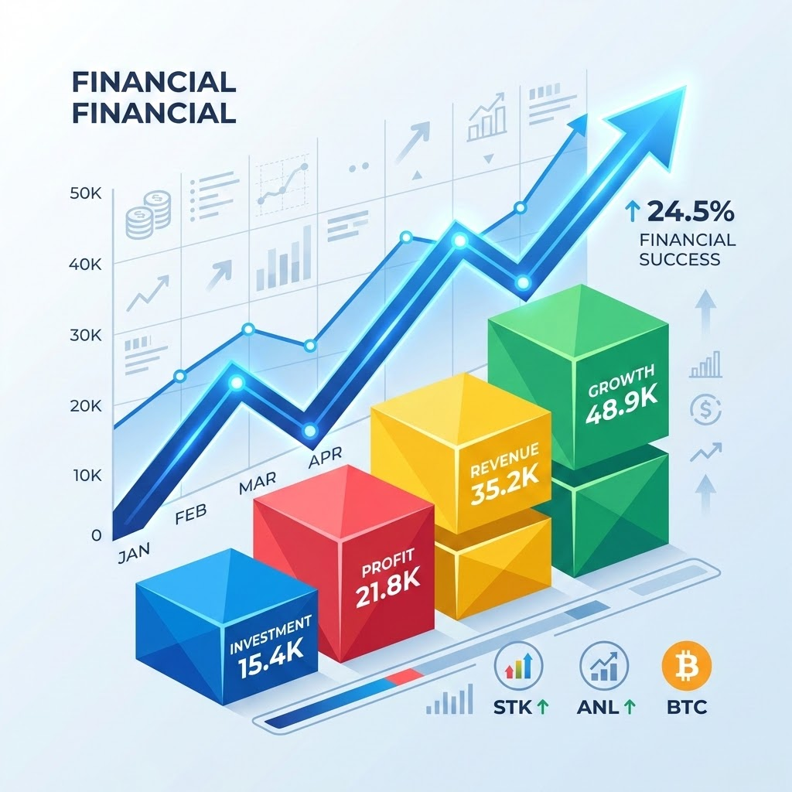
Budgeting & Forecasting
Transition to Automated Budgets
• Analysis: Analyze historical budget data and spending.
• Prediction: Predict future traffic earnings, expenditure trends, and budget needs with higher predictive accuracy.
Historical
Budget
Data
AI
Prediction
Engine
Future
Earnings &
Trends

Slide 21
IRAS Case Study
Payroll & Pension Audits
Payroll Audits
Automatically cross-check staff payroll lists to eliminate overpayments.
Pension Audits
Validate monthly pension disbursements against pay commission frameworks and historical records.

Slide 22
Closing Vision
Transitioning to Railway-Wide Agentic Networks
Vision: Transition from single-task agents to railway-wide agentic networks.
Outcome
A fully digitized, audit-compliant, and highly efficient Indian Railways financial ecosystem.

Slide 23
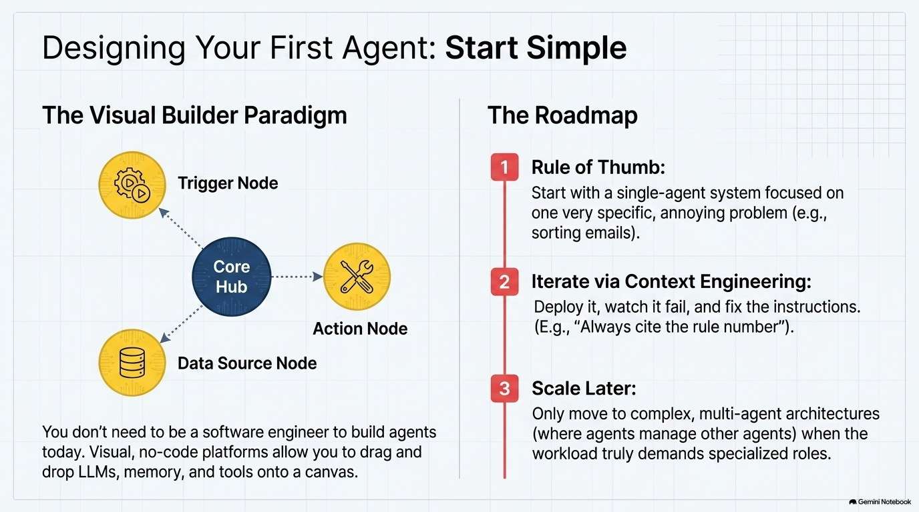

Slide 24
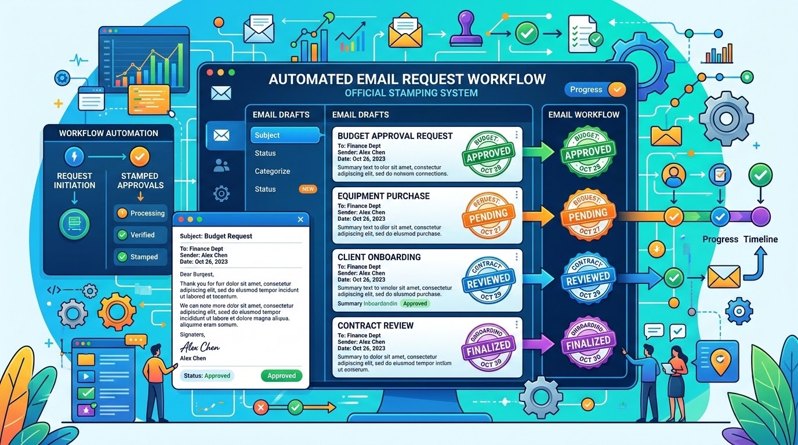
Live Project
Automatic EQ Request Sender
Request-to-Dispatch Workflow
Automatically drafts and sends Emergency Quota (EQ) to concerned officer upon receiving request.

